Slide 1
Addressing Actuator Delays in Networked
Robotic Systems
Skandhan K

Slide 2
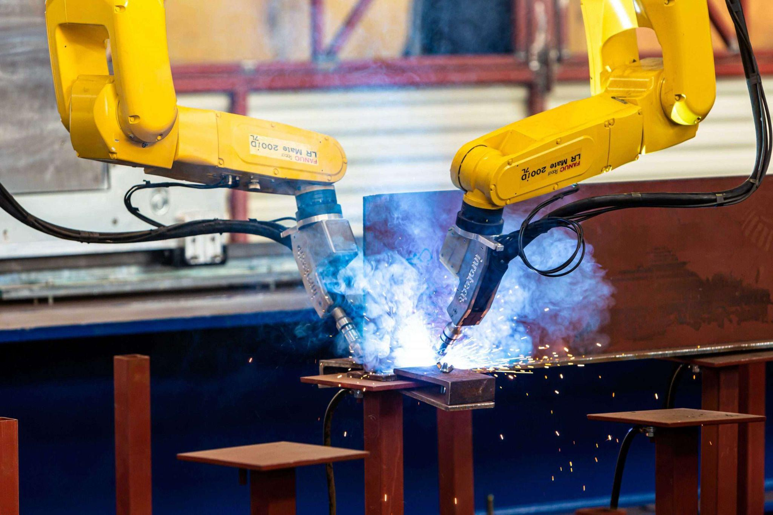
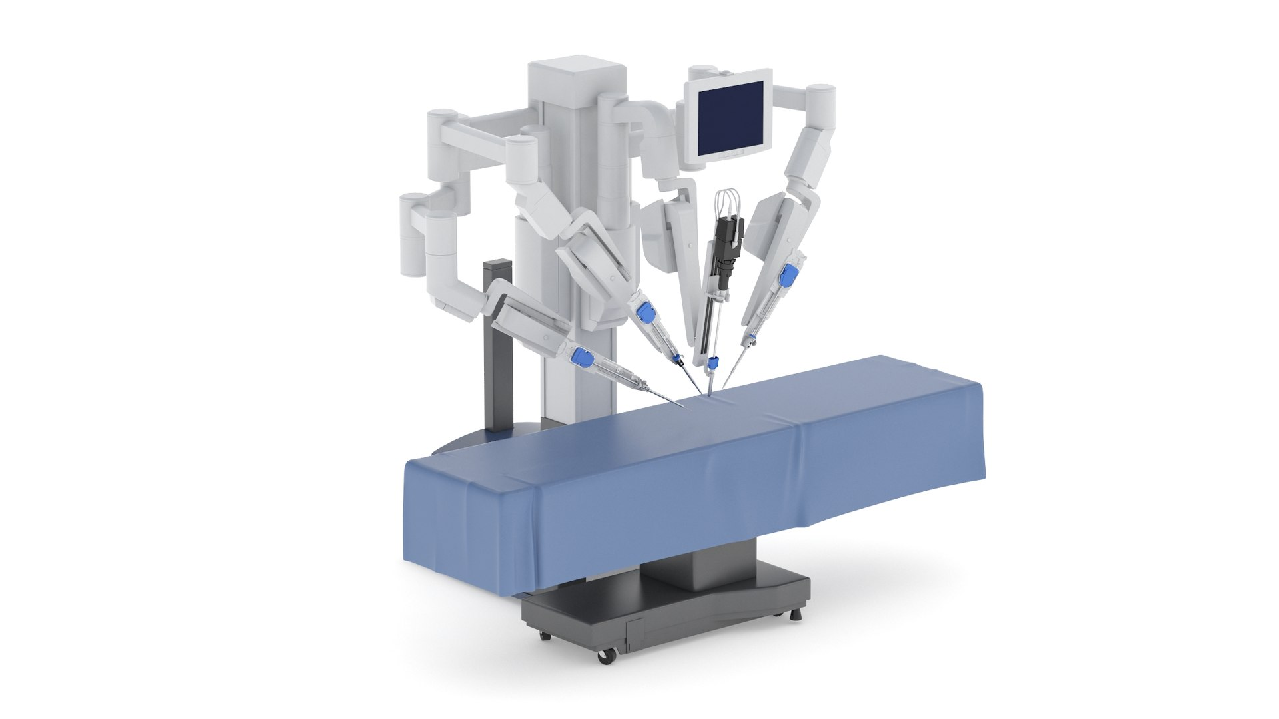
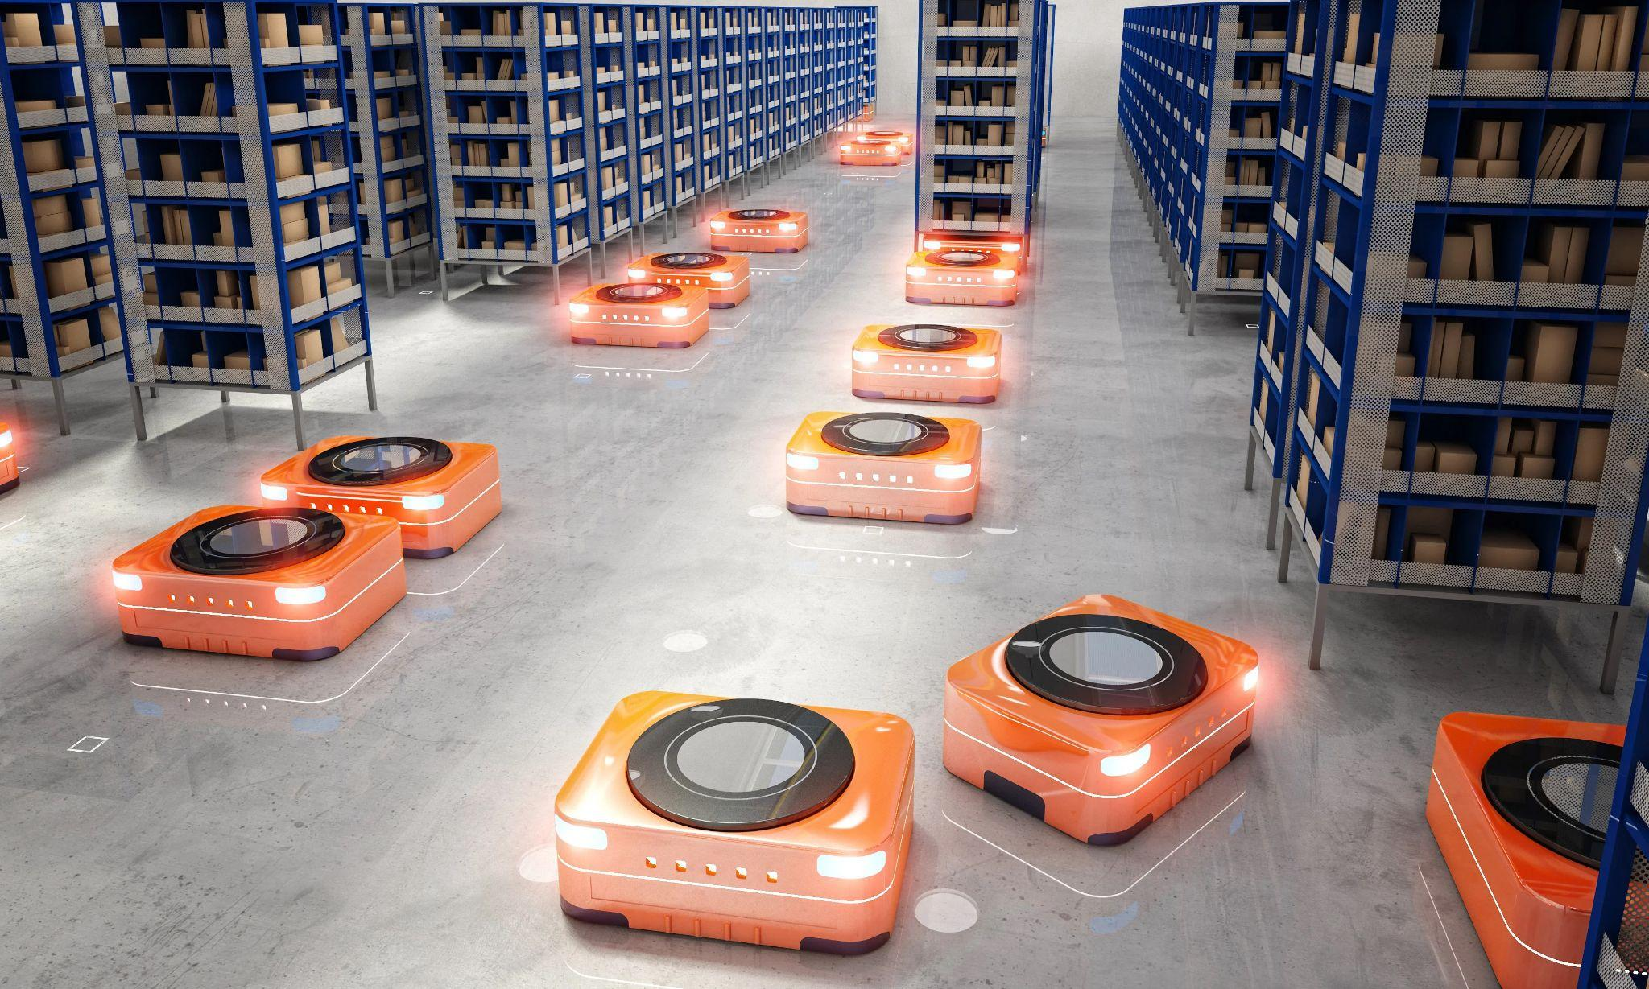
Introduction:
Networked control systems (NCS) have revolutionized automation by enabling remote control and data exchange between multiple systems. Network controlled systems (NCS) are becoming increasingly essential across a wide range of applications including: Industrial Automation, Environmental Monitoring, Telesurgery and Remote Healthcare, Process Control etc.
In these applications, the components of NCS communicate and collaborate with each other to function as a cohesive unit. By working together, robots can tackle tasks that are beyond the capacity of a single robot.
SOURCE : https://www.inrotech.com/wp-content/uploads/2020/10/5DK_6992-scaled.jpg
SOURCE : https://static.turbosquid.com/Preview/2020/02/27__23_06_47/RoboticSurgicalSystem001.jpgBBDEC5E5-D657-4C7B-94D5-68252DE55849Default.jpg
SOURCE: https://www.twintecgroup.com/hs-fs/hubfs/Robot%20Warehouse.jpg?width=7400&name=Robot%20Warehouse.jpg

Slide 3
Path graph simulations:
Centralized:
All the network agents receive information from a central source that assigns tasks and manages communication.
Easy to maintain the flow of information and simple to design.
Decentralized:
All the network agents function independently, by deciding based on local information
Complex in its structure, though being reliable and scalable.
This presentation is focussed on addressing the constraints of the decentralized networked robots (control systems)

Slide 4
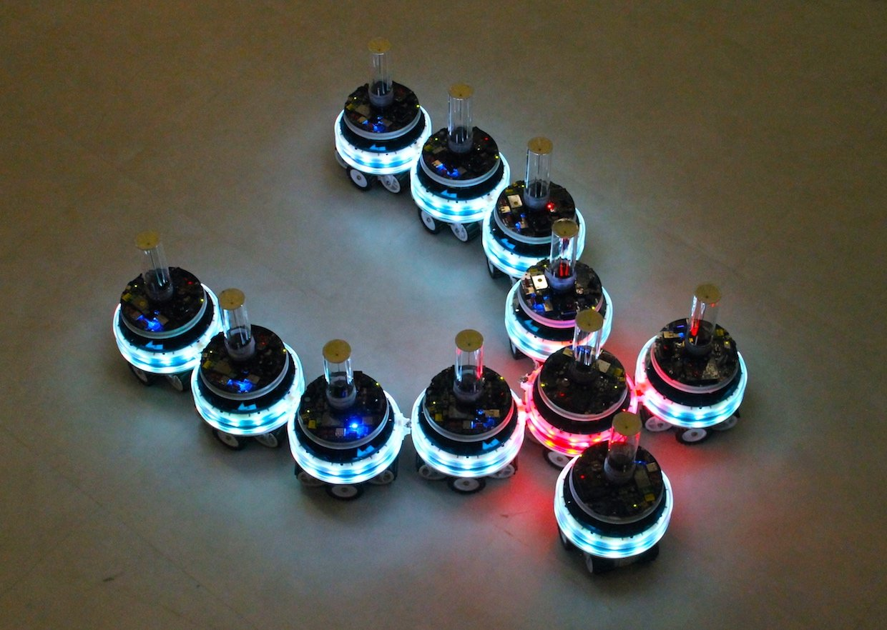
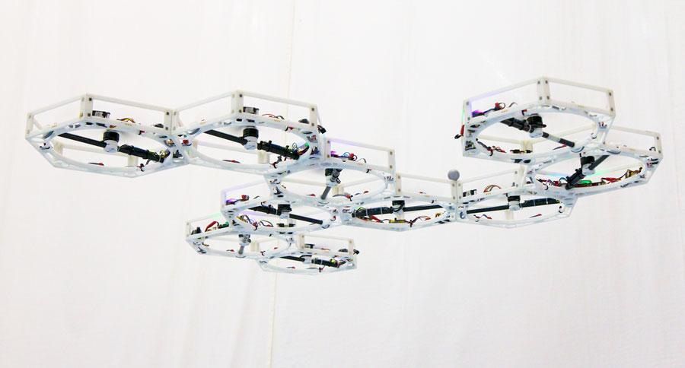
Formation Network Control and its applications
The concept of Formation Control is particularly important in these distributed, yet synchronized tasks. Formation control specifically deals with maintaining a desired spatial arrangement between multiple robots or systems within an NCS.
With Divide & Conquer approach at its heart, the network of systems automate complex tasks, reduce downtime and improve overall resource utilization.
SOURCE : https://cdn.thenewstack.io/media/2017/10/f1235e26-mergeable-nervous-system-robots-1.jpeg
SOURCE: https://www.giantfreakinrobot.com/wp-content/uploads/2013/08/swarm-bots.jpg

Slide 5
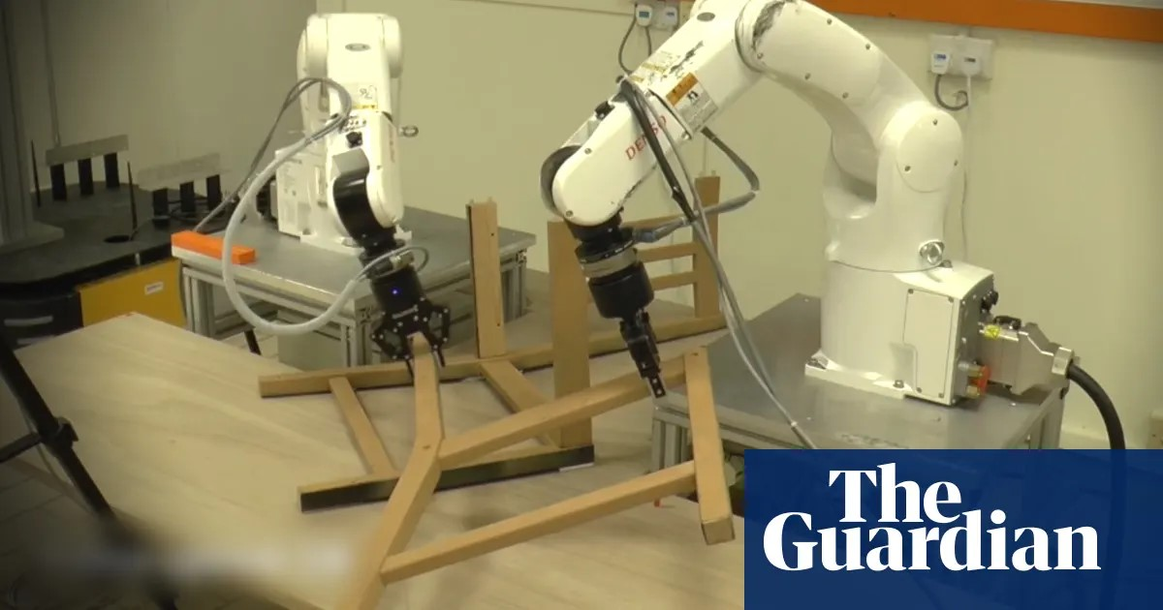
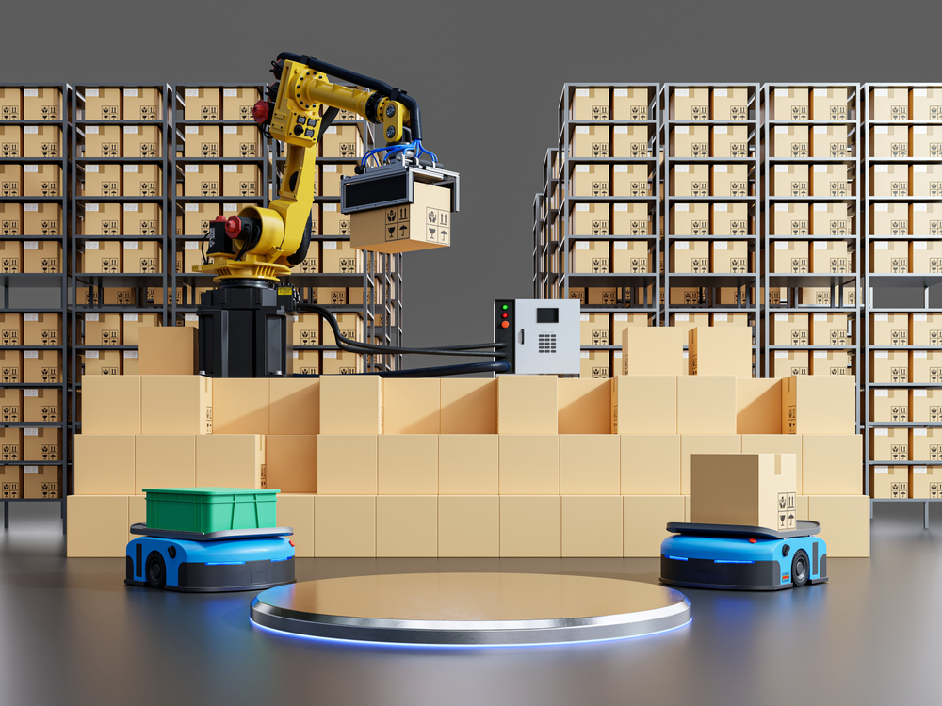
Practical issue - delays
Inherent delays involved in the process, are a major challenge to NCS.
Actuator delays hold a special significance as they represent the final hurdle in translating a control signal into a physical action. These delays can have cascading effects within the NCS.
Loss in the synchronised motion can lead to a complete breakdown of the operation, if robots in a formation are tasked with assembling a complex structure. Eventually the entire assembly process can grind to a halt.
SOURCE : https://i.guim.co.uk/img/media/7aff2be7ee8e4c74dcde5b55f7de5456d43136aa/137_168_1520_912/master/1520.jpg?width=1200&height=630&quality=85&auto=format&fit=crop&overlay-align=bottom%2Cleft&overlay-width=100p&overlay-base64=L2ltZy9zdGF0aWMvb3ZlcmxheXMvdGctZGVmYXVsdC5wbmc&s=3b1994466f2f66e0d3fe73271b903d08
SOURCE: https://howtorobot.com/sites/default/files/2021-10/warehouse-robots.jpg
Goal : Addressing the actuator delay in robotic systems

Slide 6
Table of Contents
Standard Consensus-based formation control
Cohesive formation control
Delay in physical systems
Effect of delay on cohesive approach - loss of cohesion
Compensating delay for cohesive formation control

Slide 7
Example path graph:
3
v₃
v₃= - α(v₃ - v₂)
v₂= - α((v₂ - v₃ ) + (v₂ - v₁ ))
v₁= - α((v₁ - v₂ ) + (v₁ - v₄ ) + (v₁ - v_{d} ))
v₄= - α((v₄ - v₅ ) + (v₄ - v₁ ))
v₄= - α((v₄ - v₅ ) + (v₄ - v₁ ))
2
v₂
v_{d}
1
v₁
4
v₄
5
v₅

Slide 8
Standard Consensus-based formation control
In networks of agents, “consensus” means to reach an agreement regarding a certain quantity of interest that depends on the state of all agents.
The achievement of consensus implies asymptotically converging to a one-dimensional agreement space characterized by the following equation:
V1 = v2 = v3 = … = vN
In a linear system following a distributed consensus algorithm, ⩒i = ⅀ adjij ⋅ (vj(t) - vi(t))
The collective dynamics of the group of agents following the distributed consensus protocol can be written as:
⩒ = -K*V

Slide 9
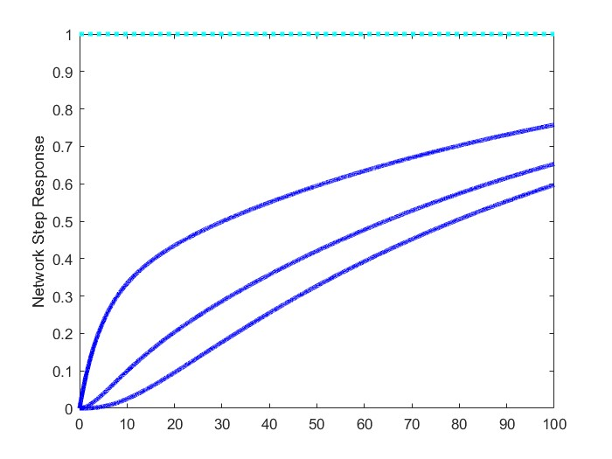
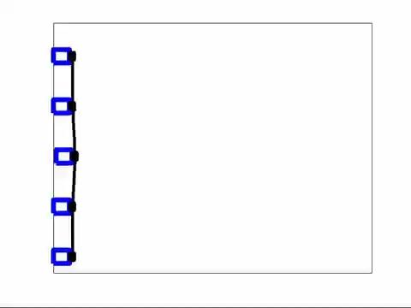
Standard consensus approach - Plot & Simulation

Slide 10


Ideal Centralized Cohesive control
Cohesive formation control is aimed at reducing the relative difference in the states of the robotic agents.
In a linear system, if each agent j is provided with access to the desired velocity vd, then the ideal cohesive update is as follows:
The collective dynamics of the group of agents following the ideal cohesive formation protocol involves the use of a column vector, 1 with all its elements as 1. The representation of the network is as follows:

Slide 11
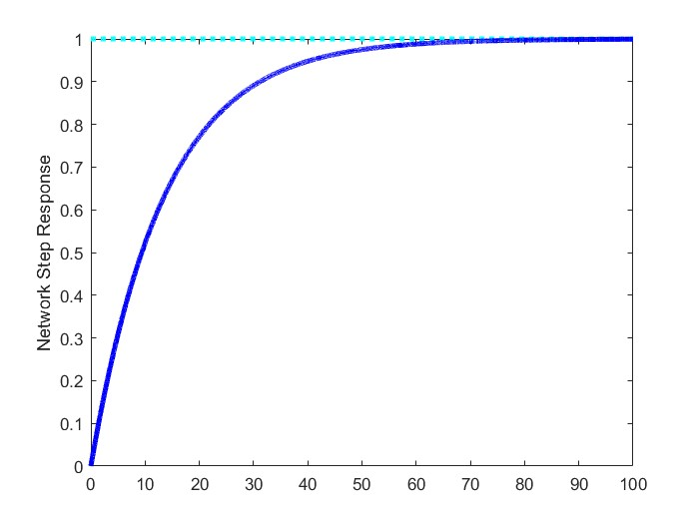

Cohesive formation control - Centralized approach

Slide 12

Cohesive formation control
Cohesive formation control is aimed at reducing the relative difference in the states of the robotic agents.
In a linear system, if each agent j is provided with access to the desired velocity vd, then the ideal cohesive update is as follows:
The collective dynamics of the group of agents following the ideal cohesive formation protocol involves the use of a column vector, 1 with all its elements as 1. The representation of the network is as follows:
In order to decentralize the system, β scaled laplacian K is multiplied on both sides of the above equation:
(Eq.1)

Slide 13
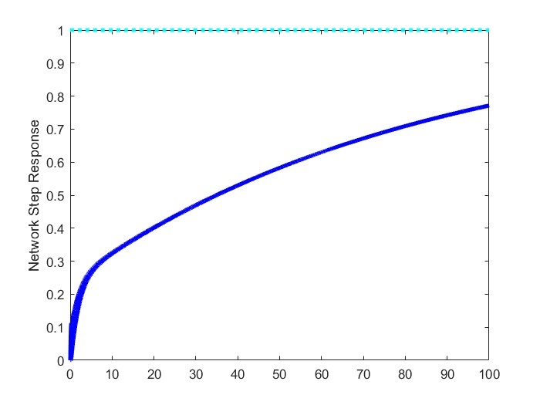
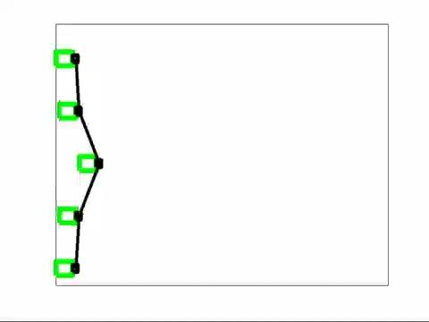
Cohesive formation control - Decentralized approach (Ideal)

Slide 14



Delay in physical systems
In real-life robotic systems, delays are detrimental. Delays introduce a time lag between when the system's state is measured and when the controller reacts. This can lead to instability
The actuators in physical systems have inherent limitations, that increase the response time and thus, making them unsuitable for the real-time setup.
The experimental robots, like the Turtlebot in the DIRo Lab follow a damped first order dynamics. The transfer function in frequency domain and thus, the expression in time domain are as follows:
As a consequence of the delay in the actuators, an additional exponential delay term, T is incorporated in the above equation as follows:
(Eq.2)

Slide 15
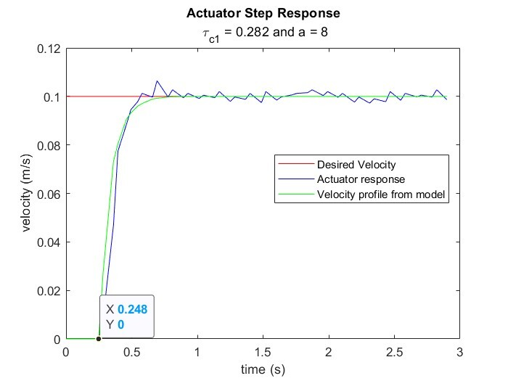
Analysis of Turtlebot
The velocity response of the Turtlebot to a step input is recorded and analyzed for determining the values of damping factor, a and delay term, T

Slide 16

Effect of delay on cohesive approach - Loss of cohesion
Analyzing equation-1 it is observed that the time derivative appears on both sides of the equation. But, in order to approximate the time derivative term in the RHS, the following approximation is employed:
When the system input is delayed by an additional term T, the equation-2 is expressed as follows:
where uc(t) is,
The above equation simplifies as follows:
(Eq.3)
(Eq.4)

Slide 17
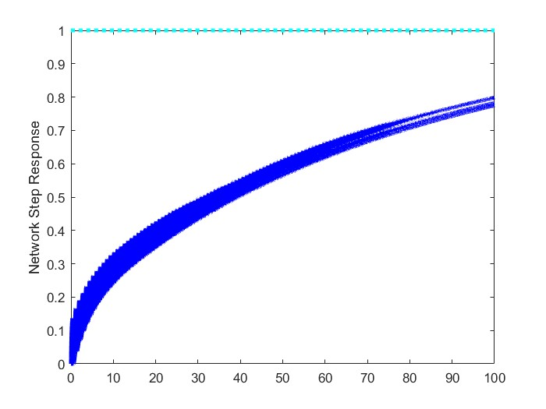
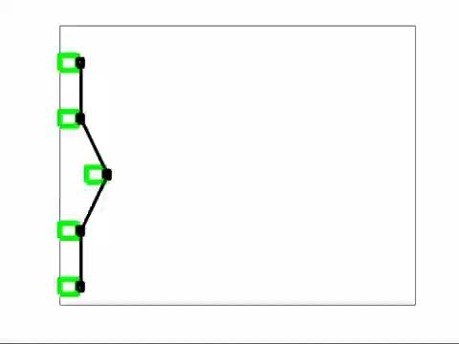
Effect of delay

Slide 18

Compensating the delay
It is observed on expansion that the loss of cohesion is primarily due to the damping based term in the RHS of equation-4.
Further as the Td increases, the system becomes unstable and loses formation.
Upon analyzing the time derivative term, one can conclude that for adequately small sampling interval, the first order approximations of the derivatives can be assumed to have the same value. In other words,
So a possible solution is the incorporation of a*Td term in the equation-4 such that:

Slide 19
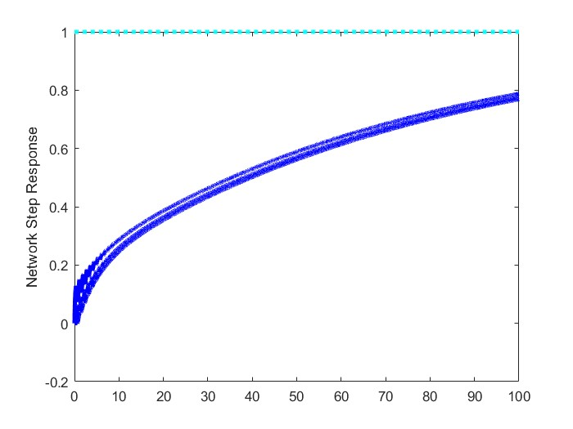
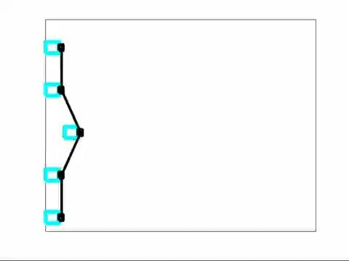
Delay compensation

Slide 20
THANK YOU!

